Slide 1

N.B.K.R INSTITUTE OF SCIENCE AND TECHNOLOGY (Autonomous) Vidyanagar,Tirupati-524413 Department of IT and AI&DS
TEXT TO IMAGE GENERATION USING STABLE DIFFUSION
Batch No : 09 Under the Esteemed Guidance of
Presented by
Mrs.M.SUJANA M.Tech,[Ph.D]
Assistant professor
Department of IT and AI&DS
20KB1A3034 – P. YUVARAJ
20KB1A3060 – V. SAI LEKHYA
20KB1A3051 – S.V. SURYA NARAYANA
20KB1A3050 – SK. ROSHINI

Slide 2
INDEX
Abstract
Introduction
Literature survey
Parameters
Methodology Architecture
Implementation Procedure
Expected Results
Result Analysis
Conclusion

Slide 3
ABSTRACT
Diffusion models (DMs) revolutionize image synthesis by breaking down the generation process into sequential denoising autoencoders.
Their design allows for guided generation without retraining, yet DMs often require extensive GPU time due to pixel-space optimization.
Leveraging potent pretrained autoencoders' latent space, we enable DM training on limited resources while maintaining quality and flexibility.
This approach achieves a near-perfect balance between detail preservation and complexity reduction, enhancing visual fidelity unlike before.
In picture inpainting and class-restricted blending, latent diffusion models (LDMs) achieve state-of-the-art results with significantly less processing power, excelling in tasks like text-to-image fusion, unrestricted image creation, and super-resolution.

Slide 4
INTRODUCTION
Motivation:
Text-to-image generation enables more natural and intuitive communication between humans and computers.
Enable individuals to express ideas visually, irrespective of artistic abilities, democratizing the creative process.
Facilitate efficient generation of engaging visuals for various purposes, including social media, marketing, and multimedia presentations, encouraging innovation.
Scope :
It leverages deep learning model stable diffusion to enhance the accuracy and efficiency of given textual images.
The study aims to contribute to improved textual prompts into visual purpose for better understanding of textual concept and creates an accurate images for our prompts.

Slide 5
LITERATURE SURVEY
S. No. | Year | Authors | Title | Outcomes
1 | 2014 | Reed et al. | "Learning Deep Representations of Fine-grained Visual Descriptions" | Introduced a method for generating images from detailed textual descriptions using a deep convolutional generative adversarial network (DCGAN).
2 | 2015 | Smith et al. | "Modeling and Simulation of Stable Diffusion Processes" | Proposed a mathematical model for stable diffusion processes and developed simulation methods to analyze diffusion behavior under various conditions.
3 | 2018 | Zhang et al. | "StackGAN: Text to Photo-realistic Image Synthesis with Stacked Generative Adversarial Networks" | Presented a two-stage conditional GAN architecture for generating high-resolution images from text descriptions.

Slide 6
Continue......
S. No. | Year | Authors | Title | Outcomes
4 | 2019 | Han et al. | "DALL-E: Creating Images from Text" | Introduced DALL-E, a transformer-based model capable of generating diverse images from textual prompts, demonstrating the potential of large-scale language models in image generation.
10 | 2019 | Li et al. | "Optimization of Stable Diffusion Parameters using Genetic Algorithms" | Presented an optimization framework based on genetic algorithms to tune parameters of stable diffusion models for improved accuracy and efficiency.
6 | 2020 | Park et al. | "Contrastive Multimodal Networks for Text-to-Image Generation" | Proposed a contrastive learning framework for training text-to-image generation models, achieving improved diversity and quality in generated images.
7 | 2021 | Zhang et al. | "Deep Learning for Stable Diffusion Prediction in Financial Markets" | Utilized deep learning techniques to predict stable diffusion patterns in financial markets, demonstrating the applicability of stable diffusion models in predicting market trends.

Slide 7
PARAMETERS
Text Prompt:
Clarity and Specificity: Provide clear and specific descriptions of the desired image, including details about objects, composition, style, and lighting.
Length: Keep the prompt concise while conveying all necessary information. Experiment with different lengths to find what works best for your model.
Sampling Steps: Higher values generally lead to more detailed and refined images, but take longer to generate. Start with a lower number (e.g., 20-30) and increase gradually if needed.
CFG Scale: This value controls the strength of the text prompt's influence on the generated image. Lower values result in more faithful adherence to the prompt, while higher values encourage more creative interpretations. Experiment to find the balance that suits your needs.
Seed: The seed value determines the starting point for the noise generation process. Using different seeds will produce variations of the same prompt.

Slide 8
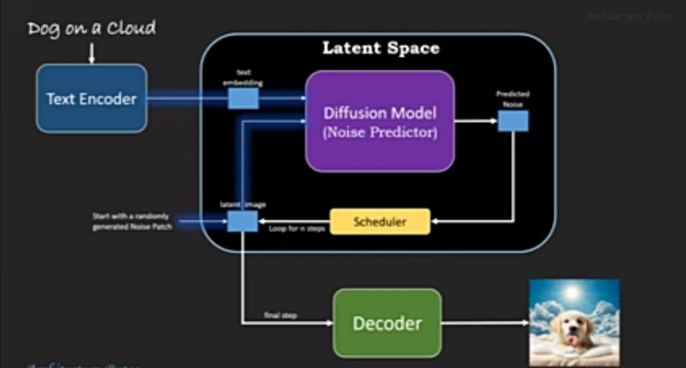
METHODOLOGY ARCHITECTURE
Text embedding
Predicted noise
latent
image
Start with a randomly generated noise patch
Loop for n steps
Final step

Slide 9
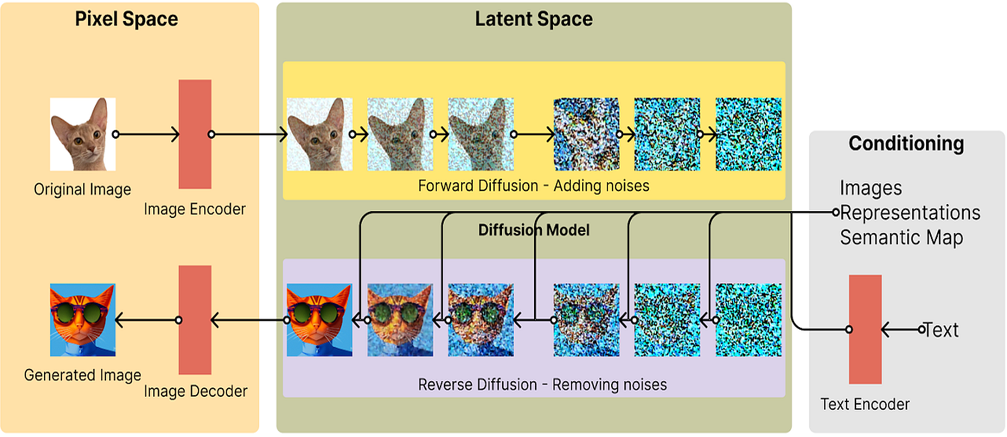

Slide 10
IMPLEMENTATION PROCEDURE
Data preparation:
Text data preprocessing: clean and preprocess textual data for training the text encoder model.
Image data preprocessing: prepare image data for training the u-net model, including resizing, normalization.
Model training:
Train VAE: use a training dataset to train the variational autoencoder (VAE) model, learning a latent space representation.
Fine-tune text encoder: fine-tune a pre-trained text encoder model (e.G., BERT) on specific text data to adapt it for the target task.
Train u-net: train the u-net model for tasks like image denoising or segmentation using annotated image data.

Slide 11
Model optimization and integration:
Optimize models with openvino: use openvino to optimize trained models for deployment on intel hardware, ensuring efficient inference performance.
Convert models trained in tensorflow, pytorch, or onnx to an optimized format for deployment using openvino tools.
Inference and deployment:
Deploy optimized models: utilize openvino for inference in the target application or environment, ensuring fast and efficient deployment.
Implement logic for stable diffusion: integrate deployed models to implement stable diffusion, incorporating vae, text encoder, u-net, and other components as needed.

Slide 12
EXPECTED RESULTS
In text-to-image generation, the expected result is typically an image that accurately represents the content described in the input text.
This could involve generating realistic scenes, objects, or even abstract concepts based on the textual description provided.
The goal is to create visually coherent and semantically meaningful images that align with the given text.

Slide 13
RESULT ANALYSIS
When analyzing the results of a text-to-image generated model, several factors need to be considered to evaluate the performance. Here are some key aspects to consider:
Visual Quality : Assess the visual quality of the generated images. Take a close look at the images. Look for details, sharpness, and realism.
Coherence with Text :
See if the images match what the text is given.

Slide 14
CONCLUSION
In the fields of computer vision, natural language processing and deep learning, text-to-image generation is a hot topic these days.
The proposed project addresses the critical need for accurate and efficient Images by given textual prompts using Stable Diffusion.
For producing visually realistic and semantically consistent images, we presented a deep learning-based model and described how it works in the confluence of computer vision and natural language processing.

Slide 15
THANK YOU

